Slide 1

Time-varying Weathering in Texture Space
by Image Imposters
Team Members:
Mohsin Mamoon Hafiz (2018101029 CSE)
Mohee Datta Gupta(2018112005 ECD)
Srivathsan Baskaran(2018101049 CSE)
Shivansh . (2018102007 ECE)
Mentor TA: Prajwal Krishna Maitin
GitHub Repo:
https://github.com/Digital-Image-Processing-IIITH/project-image-imposters

Slide 2
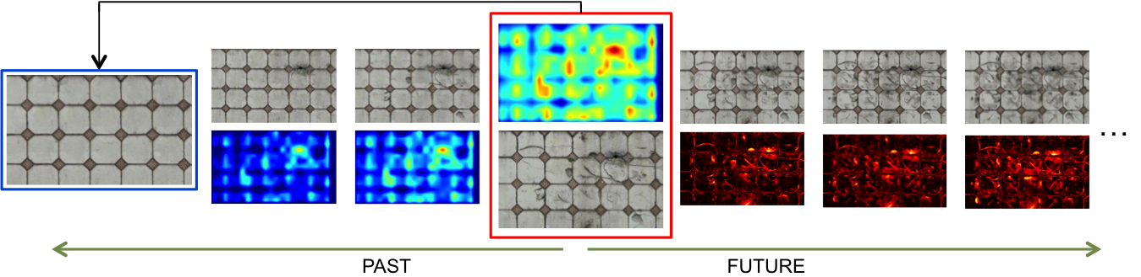
Objective
Given an input image of a weathered texture, our project aims to synthesize a series of textures emulating a weathering and de-weathering processes, yielding a time-varying texture.
Fig 1: Overview of our project

Slide 3
Steps Involved
Age Map Generation
Distance Map Generation
Generating Heat Map
Intact Texture Detection
Tile Detection
Texture Transfer
Deweathering
Weathering

Slide 4
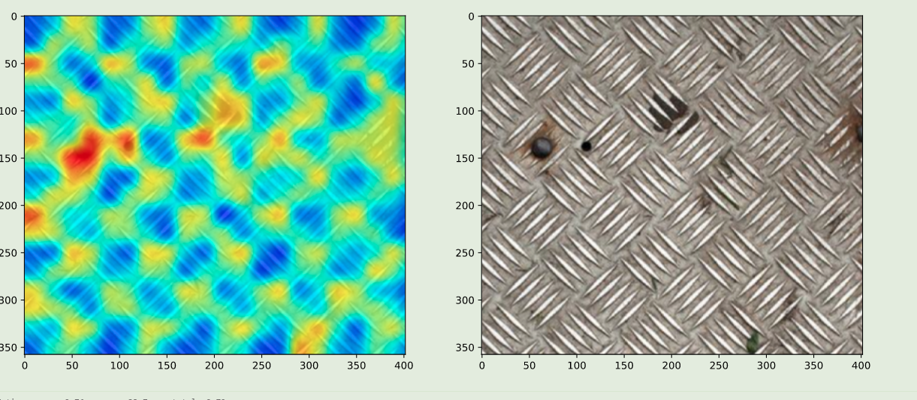
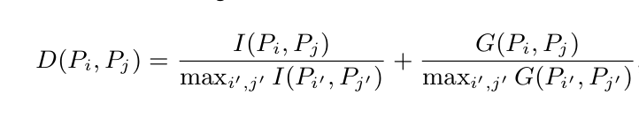
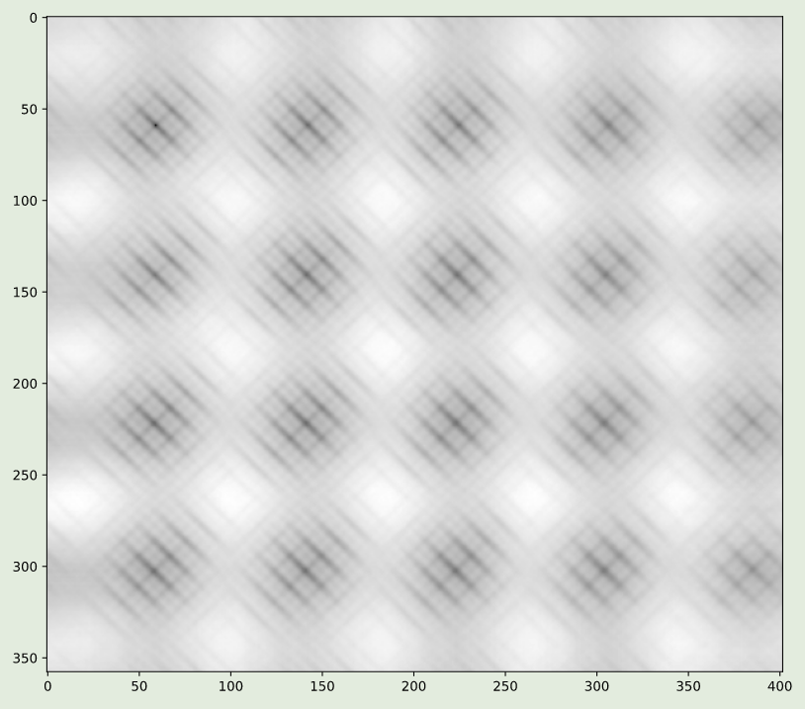
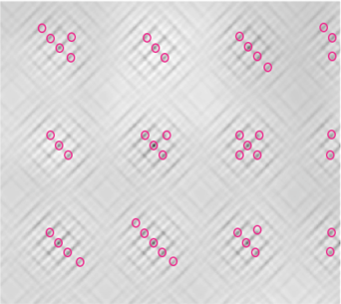
Distance Function and Distance Map
Fig 2: Input Image
Analyzing effect of luminance and gradient directions
Alternative approach (Correlation Coefficient) used to tackle runtime issues
Patch wise distance measured
Fig 3: Our Output
Fig 4: Paper’s Output

Slide 5
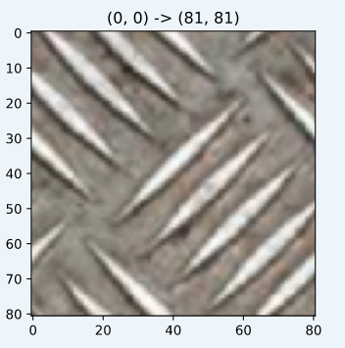
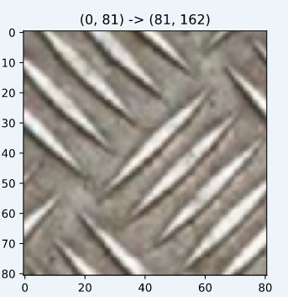
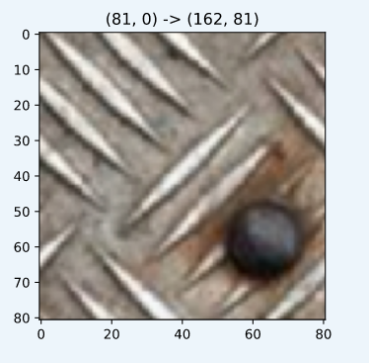
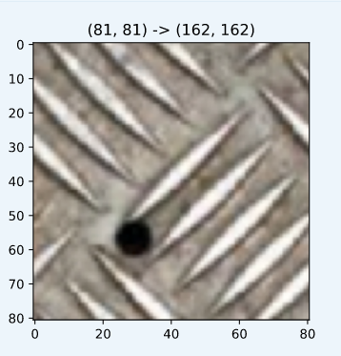
Tile detection
Locate potential tile centers
Select most prominent centers
Define repeating unit (tile)
Generate grid of repeating patterns
Fig 8: Some tiles generated of the inputImage

Slide 6
Age Map Generation
Gives the extent of Weathering of texture
The age map range - [0, 1],
For each patch - Mean of distance to nearest neighbours
Gaussian Blur for continuous age map
Fig 5: Our Age Map Output
Fig 6: Input Image

Slide 7
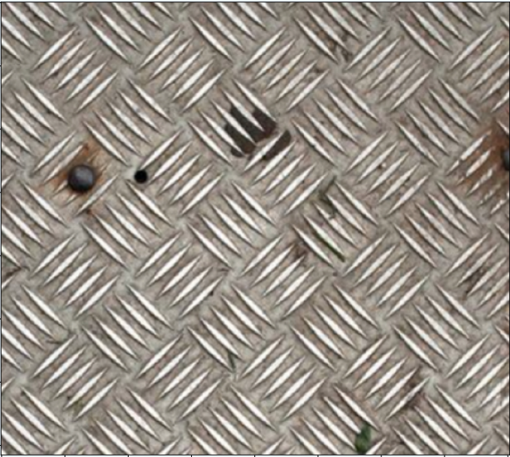
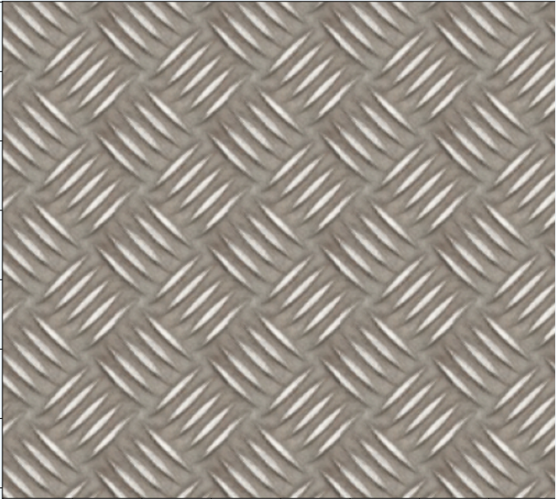
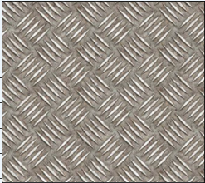
Intact-Texture generation
Used the median of the image as our template texture
Used quilting algorithm for texture transfer
Regenerated intact texture by reconstructing the template using patches of original image
Fig 8: Input Image
Fig 9: Median Image
Fig 10: Intact Texture Generated

Slide 8

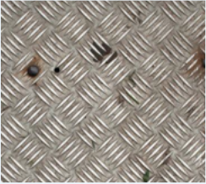
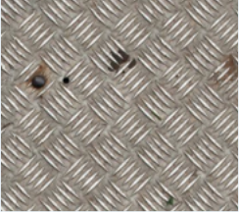
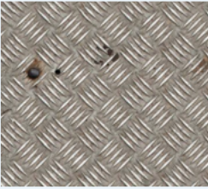
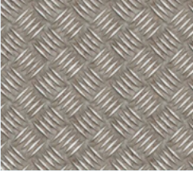
De-Weathering
For time t ([0, 1]),
This new age_map used as a guide for introducing weathering gradually
Fig 11: Input Image
Fig 12: Deweatherd Image

Slide 9
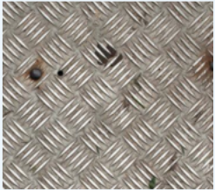
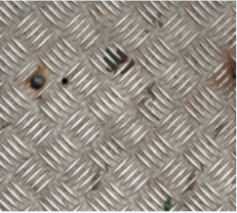
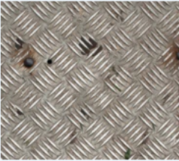
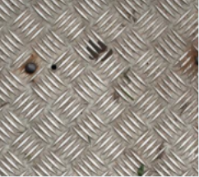
Weathering
Randomly select a patch on the input image
Add weathering to it based on its nearest neighbour ages
Overlay this patch on the input image
Fig 13: Input Image
Fig 14: Weathered Image

Slide 10
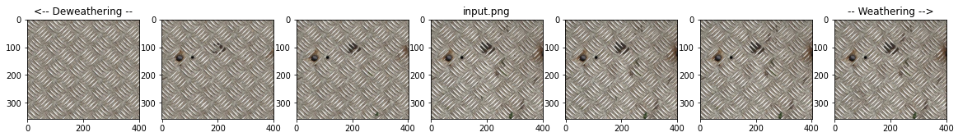
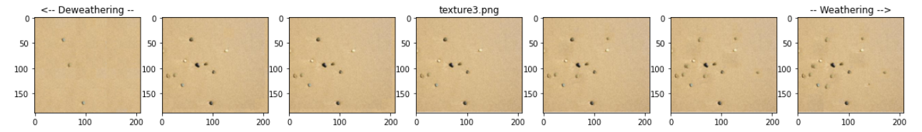
Input and Output Images

Slide 11
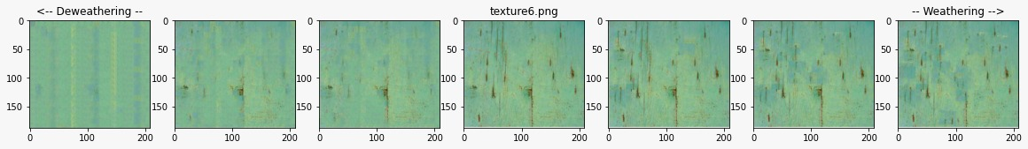
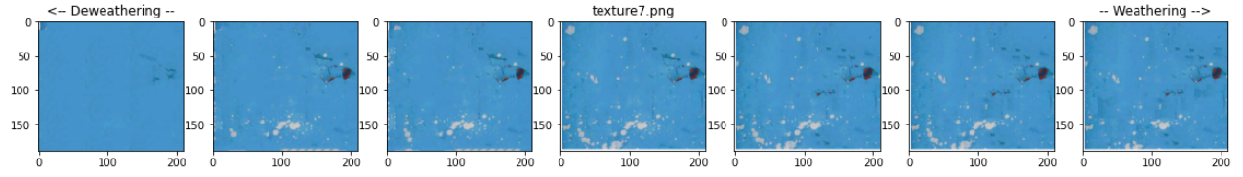
Input and Output Images

Slide 12
Differences in Approach
Distance map approach different to decrease run time
Thresholding for age map
Handling of stochastic textures was not perfect [vague description in paper]

Slide 13
References
Time-varying Weathering in Texture Space:https://www.cs.tau.ac.il/~dcor/articles/2016/TW.pdf
Quilting Algorithm:https://people.eecs.berkeley.edu/~efros/research/quilting/quilting.pdf
Class content

Slide 14
Distribution Of Work
Mohsin Mamoon Hafiz:
Distance Map, Age Map, Texture Transfer, Deweathering
Shivansh Rakesh:
Age Map, Deweathering, Weathering, Texture Transfer
Srivathsan Baskaran:
Intact texture, Distance Map, Weathering, Texture Transfer
Mohee Datta Gupta:
Tile detection, Deweathering, Weathering, Texture Transfer

Slide 15
Thank You!!

